Slide 1
Welcome to CS4222 PSLG!
With Robert and Jakub

Slide 2

Python lists​
A list is a data structure to store a collection of items​
Unlike java, python can store multiple data types on the one list​
Another major difference is that python lists are dynamic so you don’t need to define its size​

Slide 3
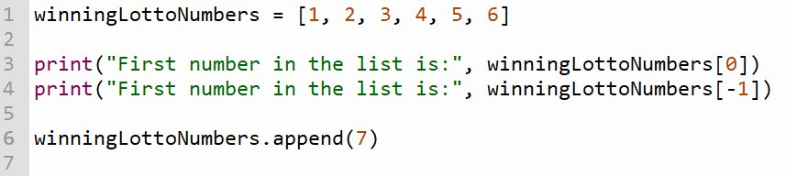
How we write it​
.append() in Python is like .add() in a Java ArrayList, it adds the item at the end

Slide 4
Problem 1
Write a python program that generates 6 random numbers and adds them to a list. After that print out the first 3 numbers.​

Slide 5
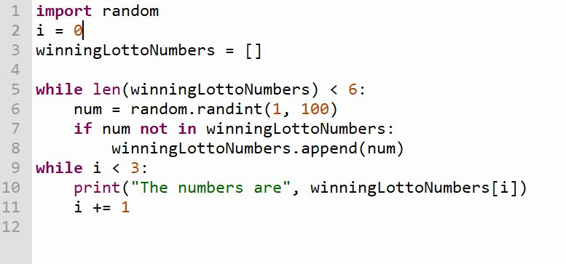
Answer:

Slide 6
Problem 2
Write a python program that fills a list with random values between 1 and 100 and adds them all together using a for loop

Slide 7
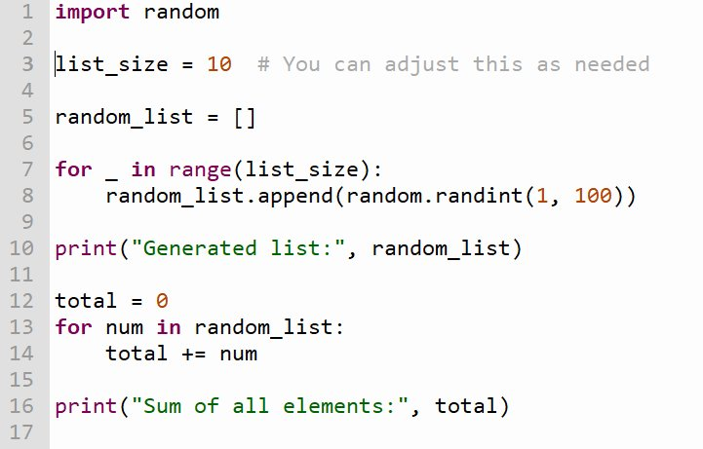
Answer:

Slide 8
Problem 3
Write a python program that fills a 2d list with random values between 1 and 100 and adds them all together using a for loop

Slide 9
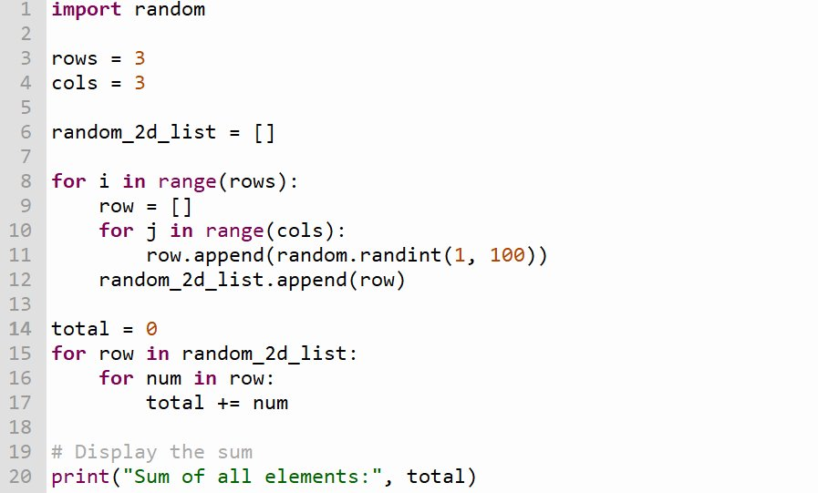
Answer:

Slide 10

Thank you for coming!

